Slide 1

RAJSHAHI UNIVERSITY OF ENGINEERING AND TECHNOLOGY
Project Report
Course no: CSE-3100
Course Title: Web Based Application Project
Submitted to:
Mohiuddin Ahmed
lecturer,
Department of Computer Science and Engineering,
Rajshahi University of Engineering and Technology
Submitted by:
Md Al Amin Tokder
Roll: 1803078
Section: B
Department of Computer Science and Engineering,
Rajshahi University of Engineering and Technology

Slide 2
Project Name :
“ Stop Ragging ”
Theory : Ragging involves abuse, humiliation, or harassment of new entrants or junior students by the senior students. It often takes a malignant form wherein the newcomers may be subjected to psychological or physical torture.
Objective :
In this project I want to implement my own idea through a website by which RUET authority can easily know how much rag occurred in our campus.
(Authority can easily detect who is the victim and who ragged others ).
By taking victims data from this website database, University administration can take necessary action to stop ragging.
Language : HTML,CSS,PHP
Database : MYSQL

Slide 3
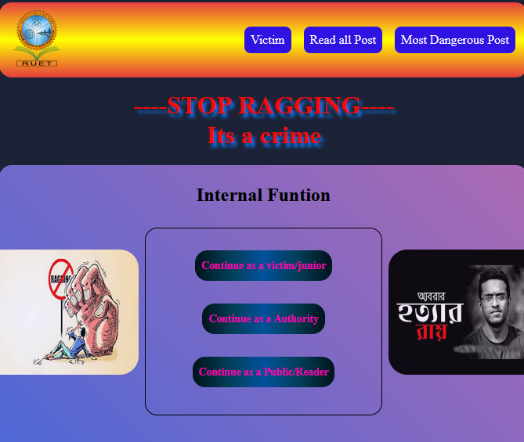
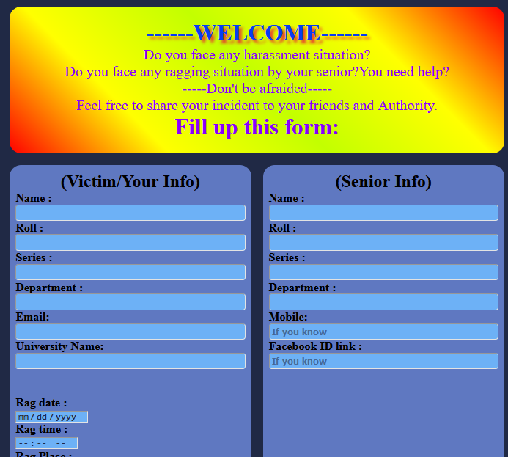
Features :
Home page :
This is homepage. It contains three part . Victim,authority and public section.
1.Victim Section:
In this section victim can describe the whole occurance briefly.He/she can included all information (Name,roll,dept,occurance place,date,time,description etc..)

Slide 4
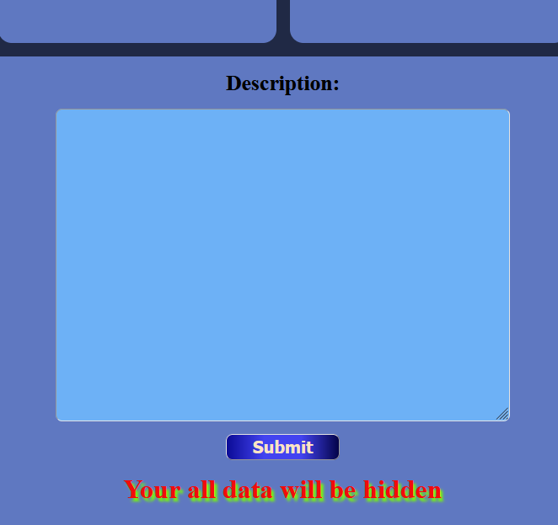
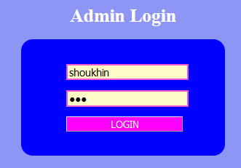
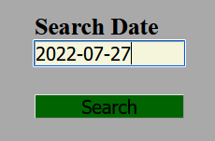
Here victim can describe the whole incidence then click to submit button .Then It
will save into the database.Website hide victims information.
2. Authority Section :
In this sections RUET authority easily get the informations of victim ,occurrence place , criminals information etc from the website hidden database . Thus they can know how much and where ragging scenario occurred in RUET . Now its time to take action !!!.

Slide 5
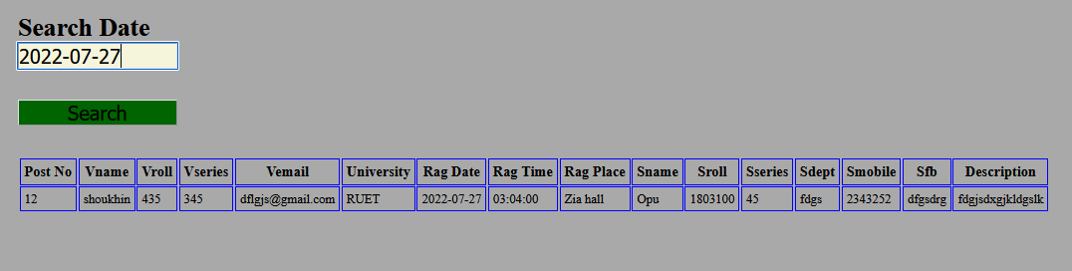
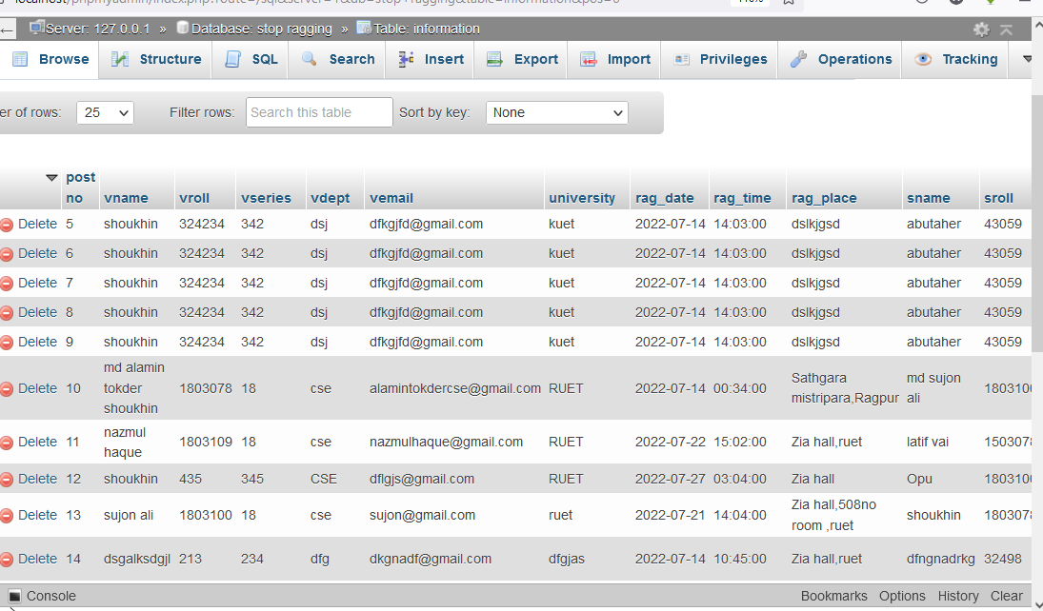
Here first of all authority should log in to the admin page
Then they can search the occurance datewise .
Authority can search data datewise . Here the database

Slide 6
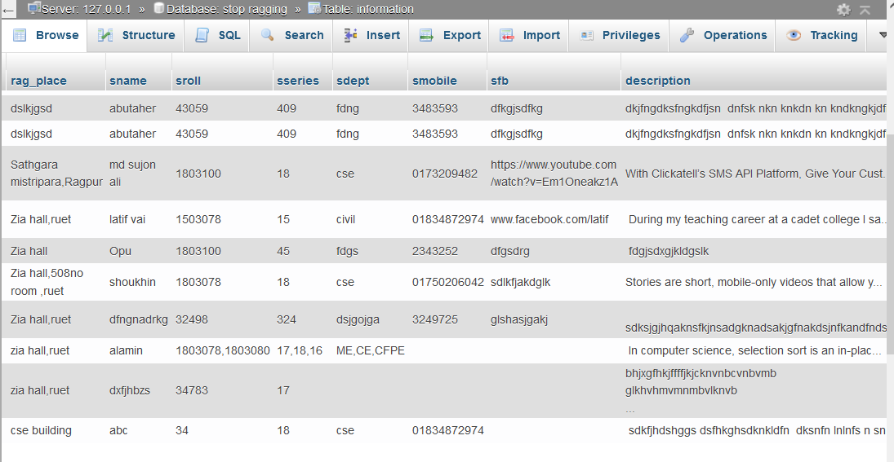
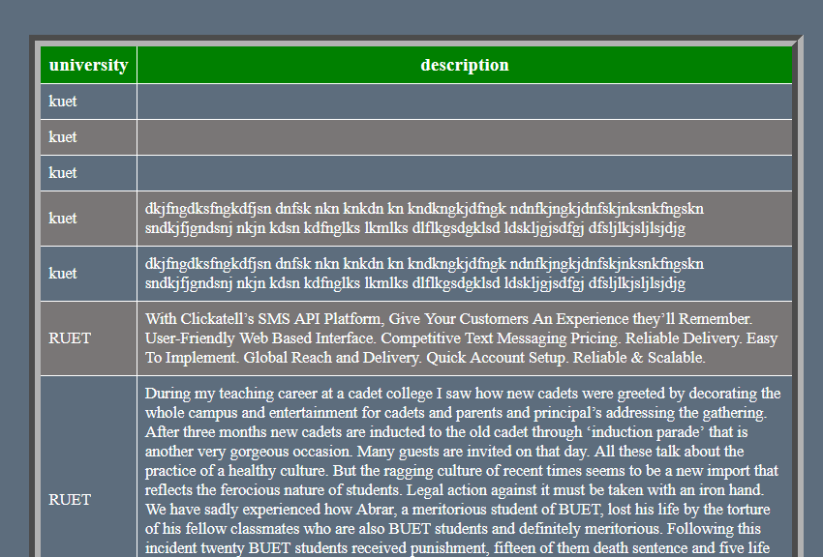
3.Public Section :
In this section any people can easily see all post and read with out any login process .

Slide 7
Limitations :
I am trying my best to implement all of my required features. There are some limitations in this project. In public sections Rating system, comment sections etc should be added . I will add this features later.
Conclusion:
This project will help our varsity to reduce any harassment situation like as ragging. Authority easily get the informations of victim, occurance place ,time ,date ,criminals information etc from the hidden database. Thus they can take necessary action.

